Slide 1
MEG Architecture
CPEG Presentation
Princeton April 2004
Peter Kriens

Slide 2
Goals
Lower software cost manufacturers and operators by providing a more granular software composition model

Slide 3
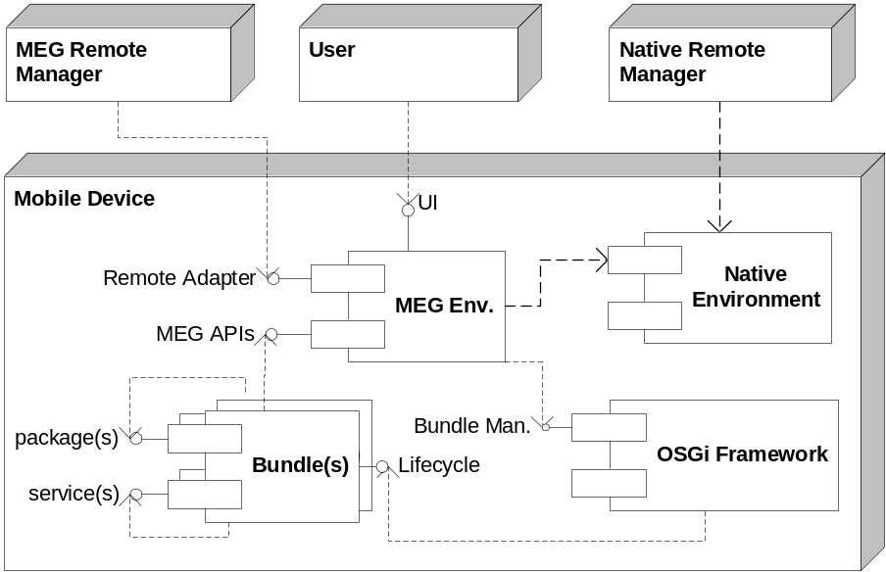
Context

Slide 4
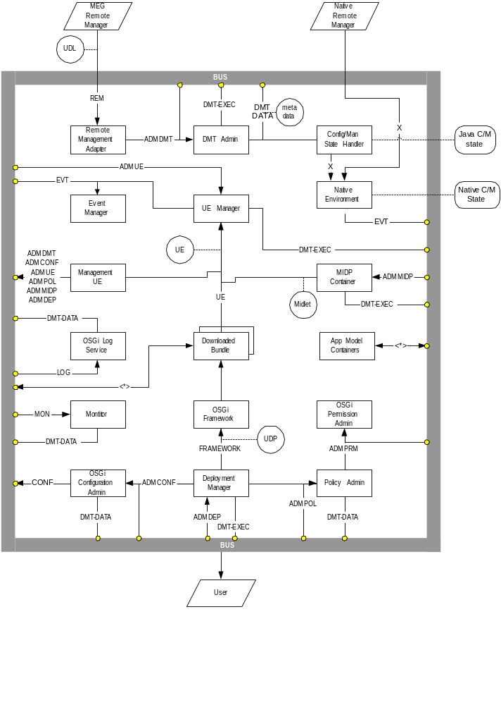

Slide 5
Management
Device Management Tree
Management System manipulates nodes with a few primitive commands:
  get, set, add, remove
Device maps those commands to operations that influence the device
Nodes standardized by OMA-DM
All manageable OSGi components will be mapped to OMA-DM nodes
Uses ACL, which are part of the hierarchy

Slide 6
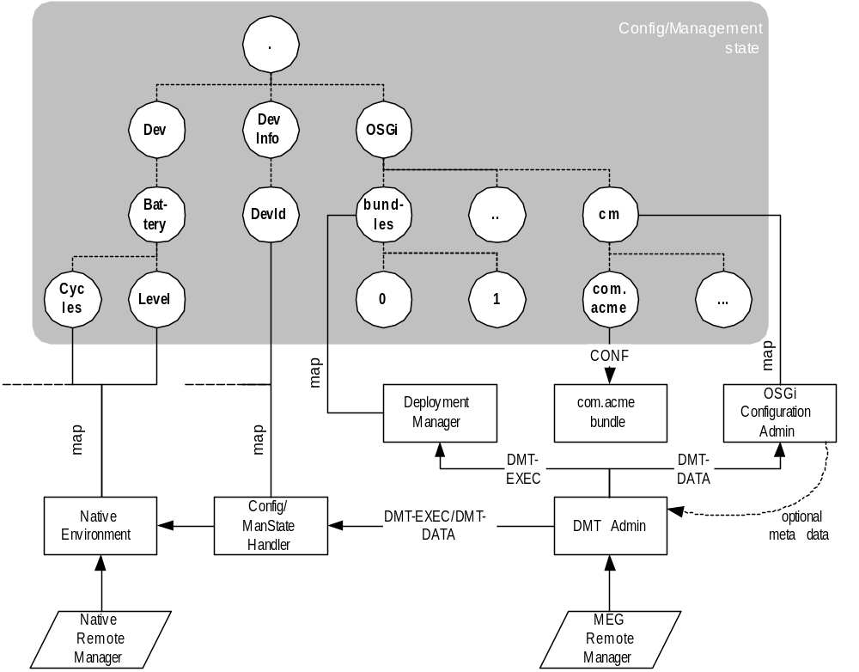
DMT

Slide 7
Management IFs
IF-DMT-DATA – DMT Admin ↔ DMT Plugin data interface
  Allows DMT Plugins to handle DMT node/sub-tree creation requests
  Allows DMT Plugins to handle DMT node/sub-tree remove requests
  Allows DMT Plugins to handle DMT node values/property manipulation requests
  Provide optional meta data to validate DMT access
IF-DMT-EXEC – DMT Admin ↔ DMT Plugin EXEC interface
  Allows DMT Plugins to handle EXEC request on DMT nodes
IF-ADMDMT – DMT access interface
  Access to the whole DMT (add/remove/get/set/exec)
  DMT event publishing

Slide 8
DMT Architecture
Manager
DMT
Admin
Exec
Plugin
ADMDMT
DMT-EXEC
0..*
0..*
1
0..*
1
DMT-DATA
0..*
Manage-
ment UI
Remote
Manager
Data
Plugin

Slide 9
Deployment
Downloaded
Bundles
Policy
Admin
OSGi
Framework
UDP
OSGi
Conf Admin
Deployment
Manager
Policy
Admin
ADMCONF
ADMPOL
UDL
DMT-EXEC
DMT
Admin
DMT-DATA

Slide 10
UE Manager
An artifact like MIDLet for application developers
One bundle can contain multiple UEs
IF-UE – UE ↔ UE Manager interface.
  UE manager is able to discover UEs
  UE manager is able to control the lifecycle of UEs
  UE startup parameters can be set
  UE manager is able to deliver events to UEs
  UE Manager is able to launch the same UE multiple times with different parameters from its descriptor

Slide 11
Events
IF-EVT – Event interface
  Receive events
  Subscribe to events
  Publish events
Very much seen as related to UEs

Slide 12
UEs
Events
Event
Manager
EVT
UE
Manager
UE
UE
Downloaded
Bundle
MIDP
Container
Other App
Containers

Slide 13
Monitoring
IF-MON – Monitor ↔ Downloaded Bundle
  The Monitor is able to discover the KPIs published by the bundle
  The Monitor is able to retrieve the value of any KPI published by the bundle
  The Monitor can accept a notification from the bundle being monitored

Slide 14
Monitoring
Monitor
Downloaded
Bundle
DMT-DATA
MON

Slide 15
Issues
Security
  DMT contains ACLs, Permissions and Policy
Deployment model
  UDP and UDL
DMT versus Java interfaces
GUI

Slide 16
Way Forward
MEG will use existing work streams to create RFCs
Leads will make initial proposal

